Slide 1

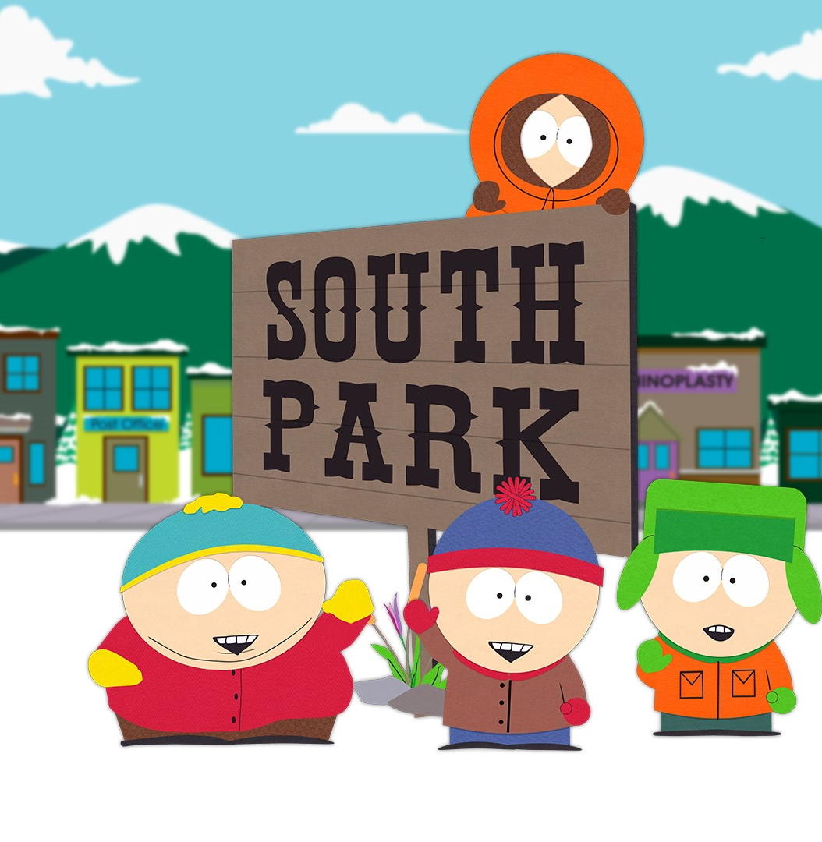
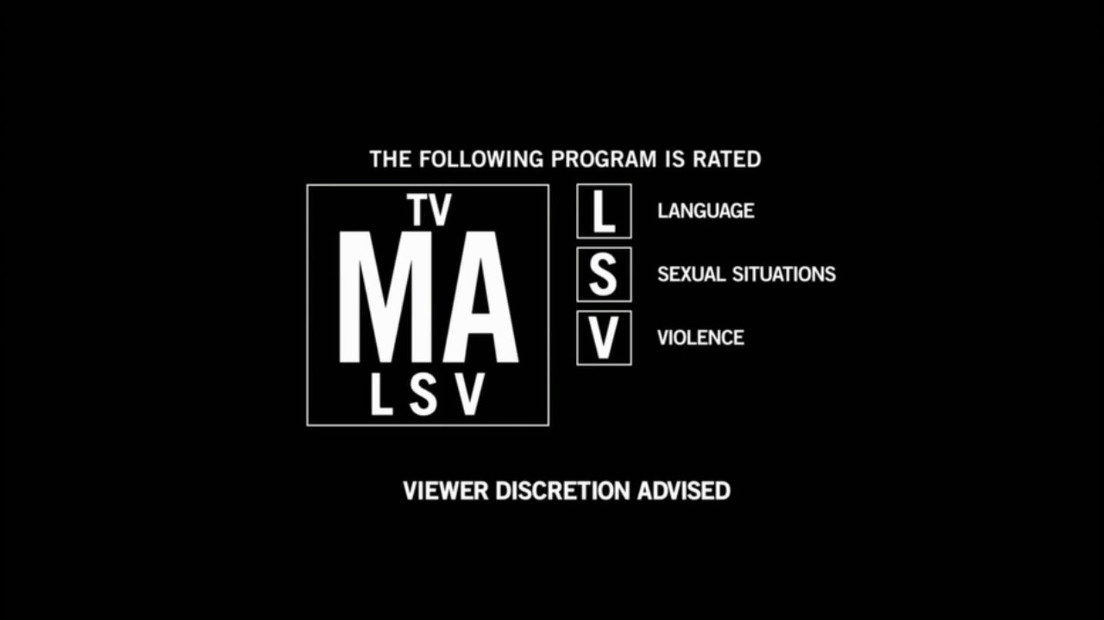
Tegridy Farms
Data Analysis with Tegridy
Notes:
Nashra

Slide 2
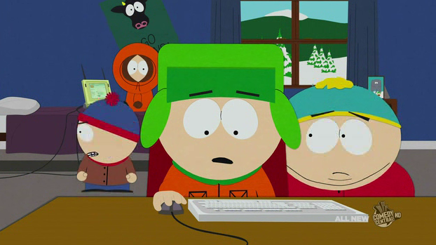
The Background: South Park is an comedic animated sitcom that has aired on Comedy Central for over 25 years Shows theme and adult humor: Dark Profane Social Satire Political Shows popularity and creators
*This is us beginning our project
Notes:
South Park is an comedic animated sitcom that has aired on Comedy Central for over 25 years. It follows a dysfunctional small group of Coloradoan 4th graders and their exploits in the titles hometown. It has became synonymous with dark, profane, sexual innuendo, and adult humor. The show has remained popular and culturally relevant as social satire, pop culture, political references, and numerous other gags have remained the shows bread and butter from the shows hilarious creators Matt Stone and Trey Parker.

Slide 3
Political Correctness Cancel Culture Everything offensive Has one of the most offensive shows softened?
Wait, but what does South Park have to with data analytics?
Notes:
In our contemporary world of politically correctness, where general consensus of culture shuns, cancels, or otherwise finds most anything offensive this show has indeed remained a constant. After some research and data digging we began to wonder…Has one of the most offensive, infamous, no holds barred shows in history become less offensive as time and culture has progressed? So, this is a quantitative sentiment analysis of the dialogue of the characters, jokes, and offensiveness of the TV series SouthPark. We do a deep dive into the words of SouthPark, over 70,000 lines taken from 18 full seasons, to see if we can pick out some underlying trends to see if one of TV’s most extreme shows has indeed become more socially acceptable.

Slide 4
Hypothesis and the Scientific Method:
Claim: Has SouthPark become less offensive over time?
We will be using sentiment analysis, graphs, correlation, and linear regression using linear equation where M is the slope of the line to see if the slope (shows offensiveness) has become more positive, negative, or remained neutral.
Null Hypothesis: We believe South Park has not changed at all over time!
H₀: M in M = 0
Alternative Hypothesis 1: SouthPark has become less offensive over time
H_{A1}: M < 0
Alternative Hypothesis 2: SouthPark had become more offensive over time
H_{A2}: M > 0
Notes:
Our groups null hypothesis is that SouthPark has not changed at all in offensiveness over time even as culture has become more sensitive to the type of jokes the SouthPark built its show upon. Our hypothesis is assumed to be true and thus will be tested against the shows extreme language, usage of racial dialogue, radical ideologies, political jokes, religious jokes, and other criteria and parameters to create a sentiment analysis of the shows offensiveness. We will also look at user ratings of seasons or episodes correspond to those characters saying the most slanderous things. We will then use linear regression to determine if the show has become less offensive or more offensive over time and subsequently more or less popular. After our analysis is conducted from the collected data, we will either accept or reject our null hypothesis for the alternative hypothesis which is a.) The shows offensiveness has decreased over time or b.) The shows offensiveness has increased over time.

Slide 5
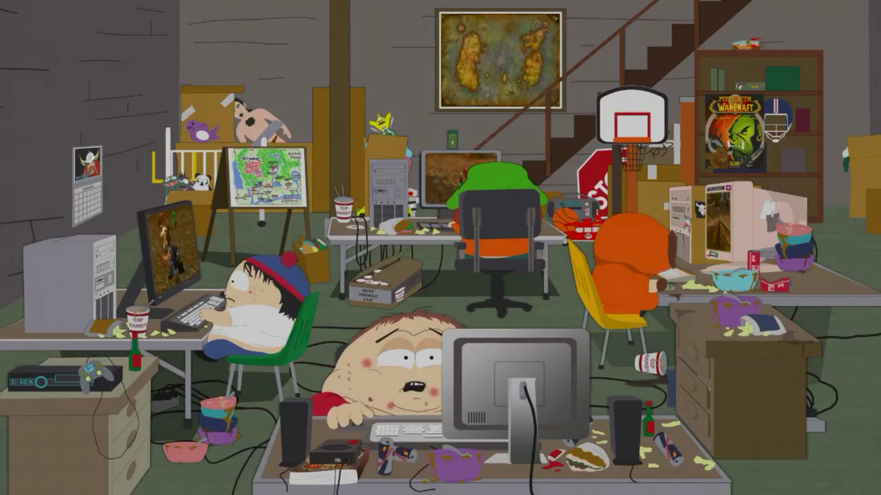
Pseudocoding & Identifying our data source: “South Park Dialogue: More than 70,000 lines of dialogue by season, episode, and character.” via Kaggle
Identifiying our dependencies: TextBlob, NLTK, Sklearn, TermColor, Better_Profanity, TfidVectorizer
Coding
Sentiment Analysis: Vader Sentiment
Analyzing and plotting our results
Our Methods of Analysis
*This is our breakout room
Notes:
Pseudocoding & Identifying our data source: “South Park Dialogue: More than 70,000 lines of dialogue by season, episode, and character.” via Kaggle
Identifiying our dependencies: TextBlob, NLTK, Sklearn, TermColor, Better_Profanity, TfidVectorizer, TweetTokenizer as well as matplotlib, pandas, numpy, and a few other libraries.
Coding: Parsing out lines by season, character, and episode. Creating cleaned databases by filtering regular words against swear, profane, racial, political, or offensive words into a list and sorting them by season.
Sentiment Analysis: Running a sentiment analysis to score words as positive or offensive using VaderSentiment.
Analyzing and plotting our results: We used linear regression, sentiment analysis, statistical regression and statistical significance.

Slide 6
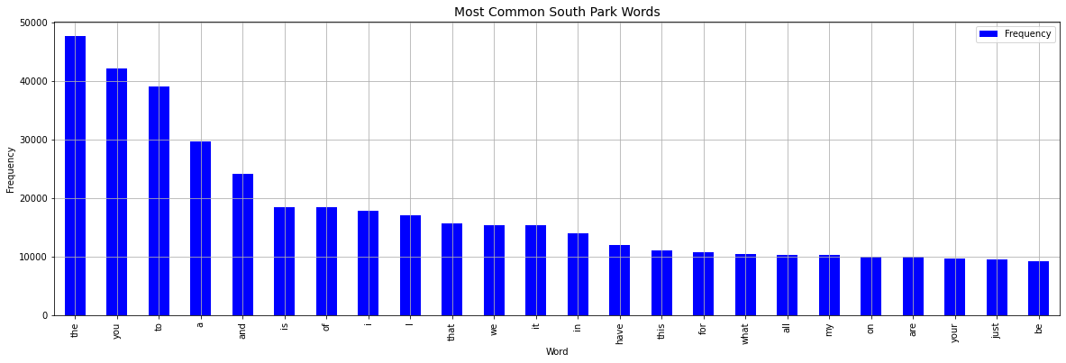
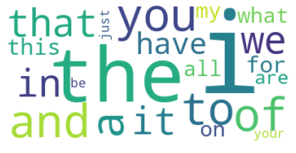
Most Common South Park Words

Slide 7
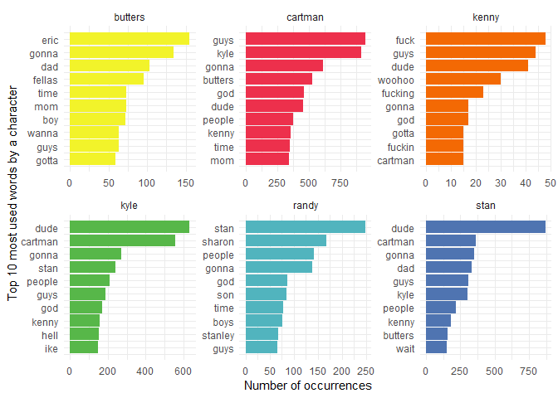
Most Common South Park Words

Slide 8
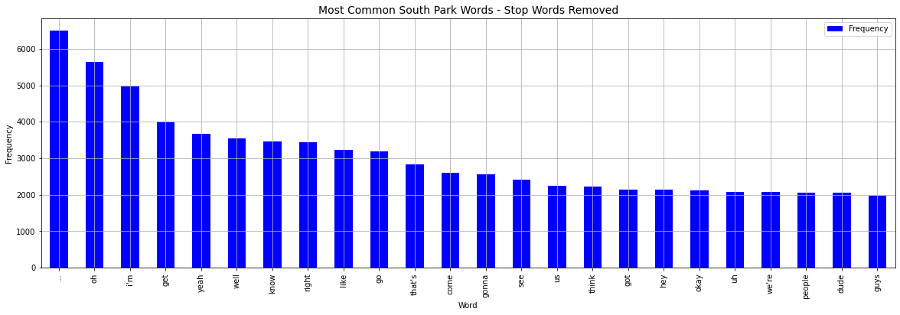
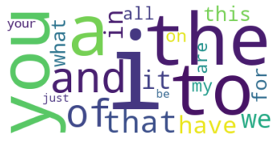
Most Common South Park Words
with ‘Stop Words’ Removed

Slide 9
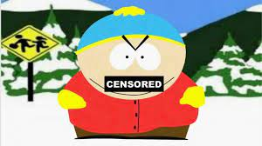
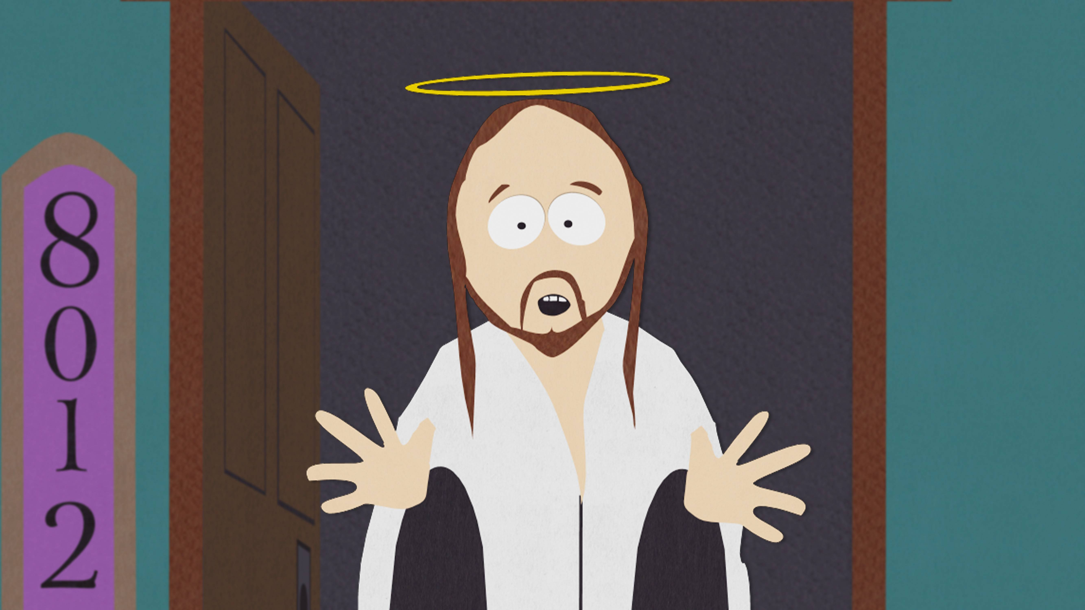
Would the class like to see the swear list we extracted?
Yes, please wake us up!
No, let us see some sentiment analysis!
Please Type “1” in chat
Please Type “2” in chat
Notes:
Take poll and proceed accordingly.

Slide 10
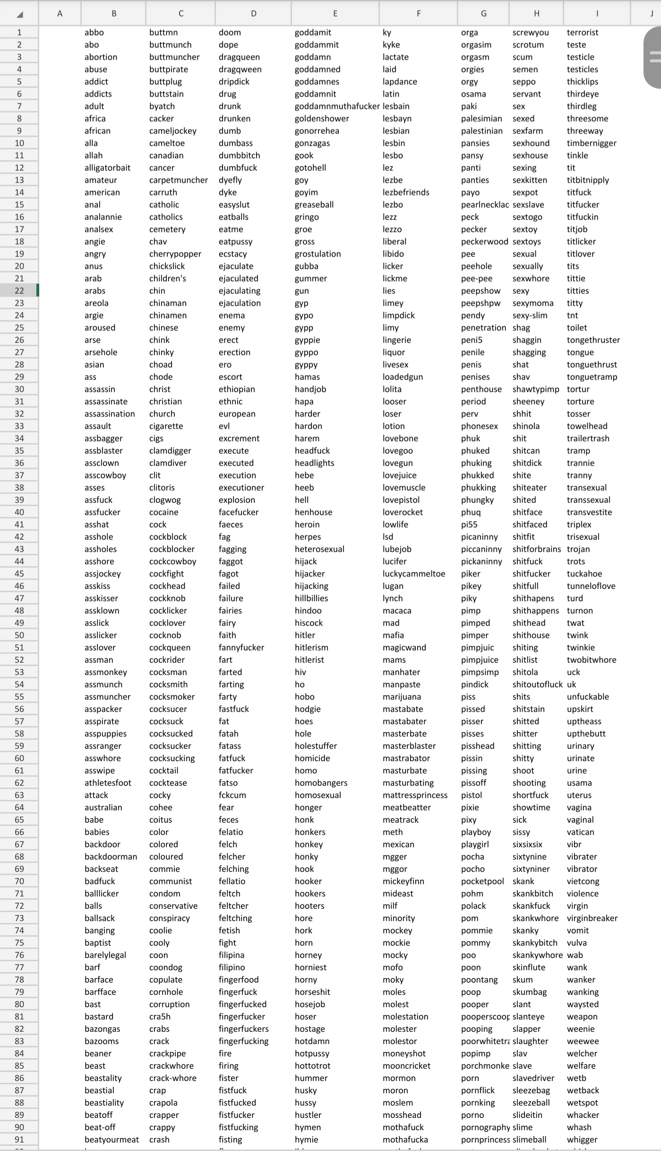
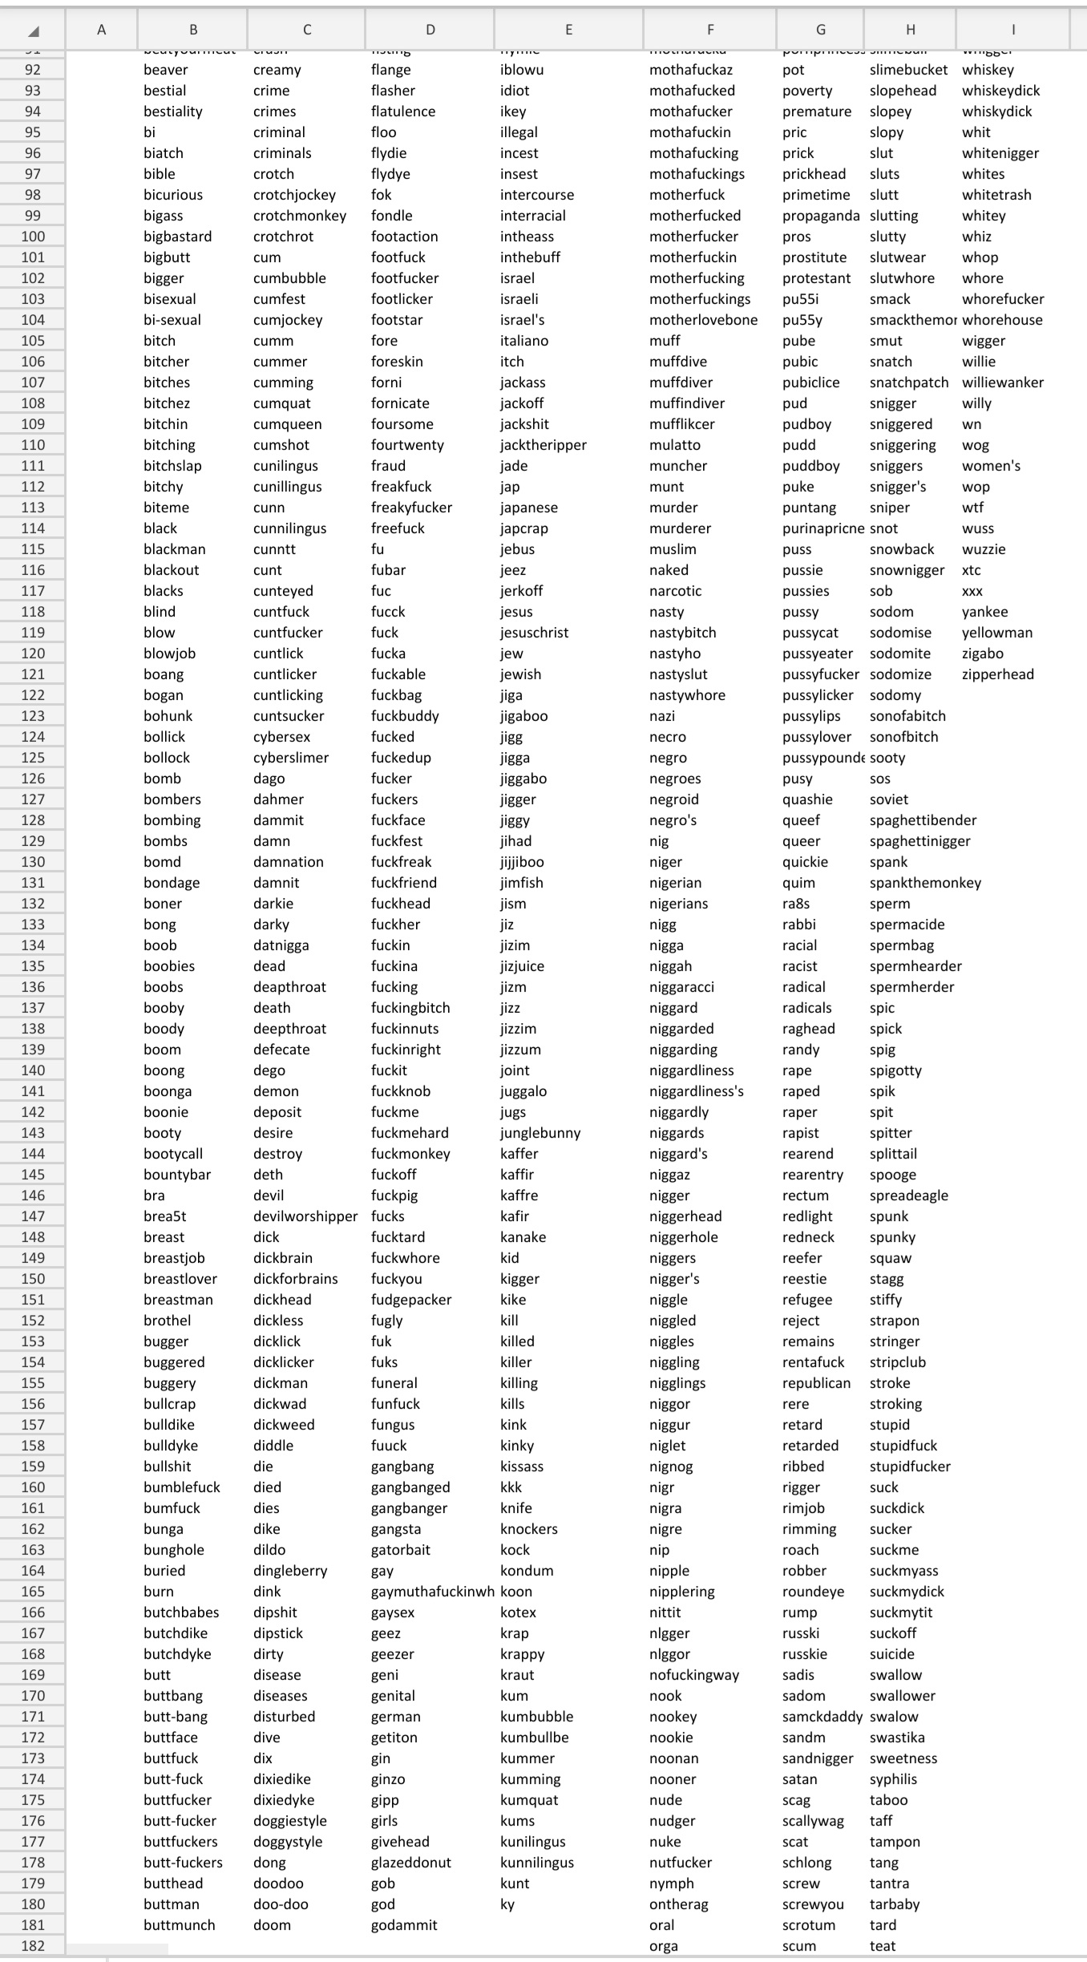
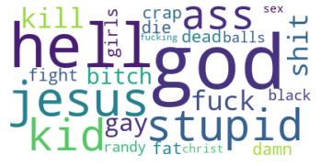
The Swear List

Slide 11
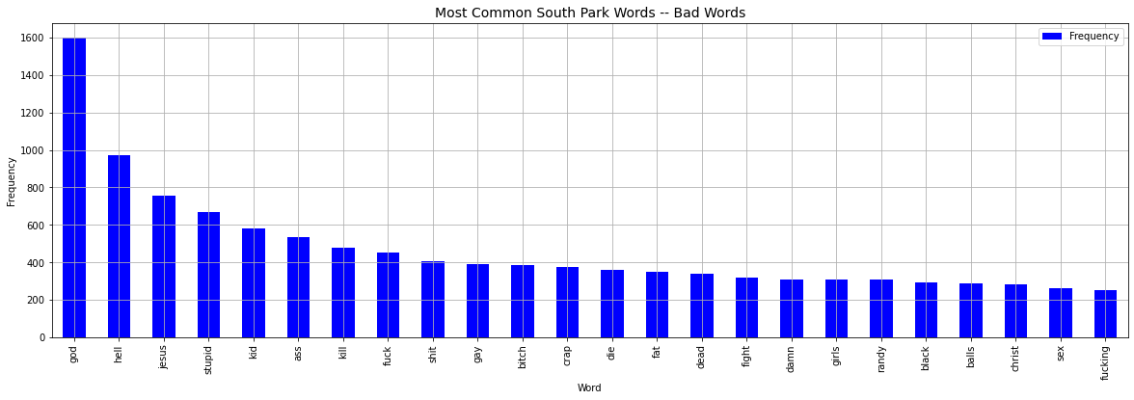
The Swear List by Frequency

Slide 12
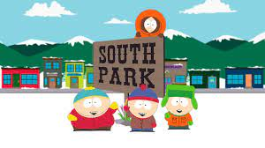

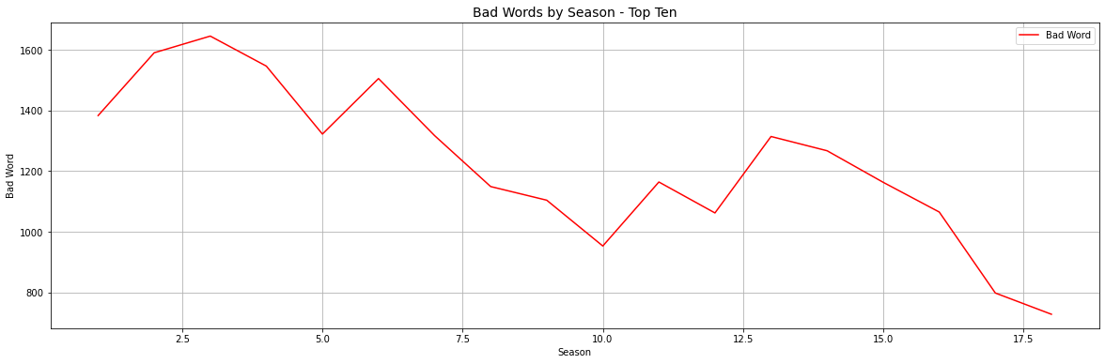
Swear Words by Season

Slide 13

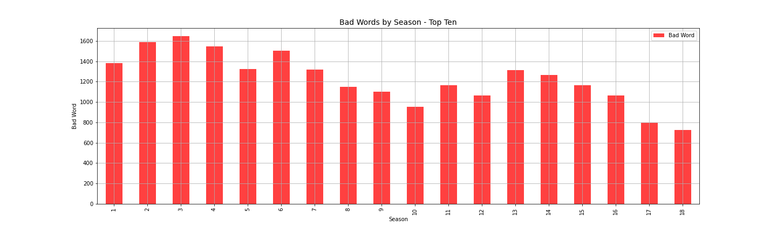
Swear Words by Season

Slide 14

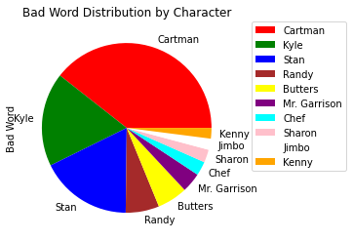
Swear Words by Character
Notes:
Color the characters differently//

Slide 15
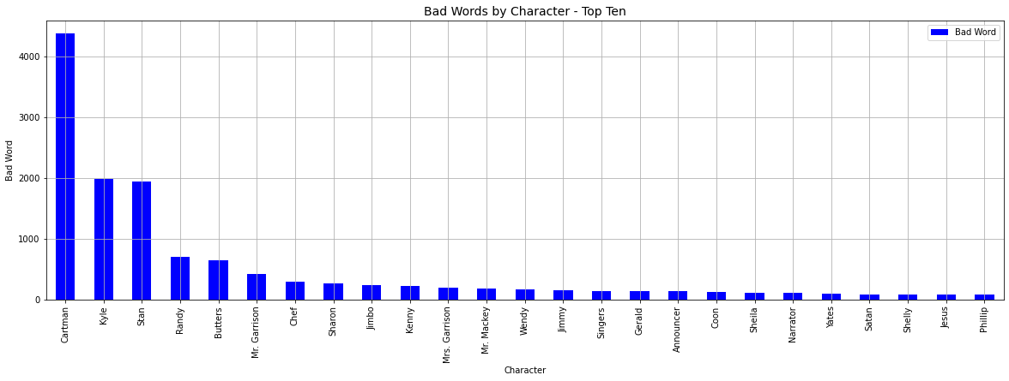
Swear Words by Character

Slide 16

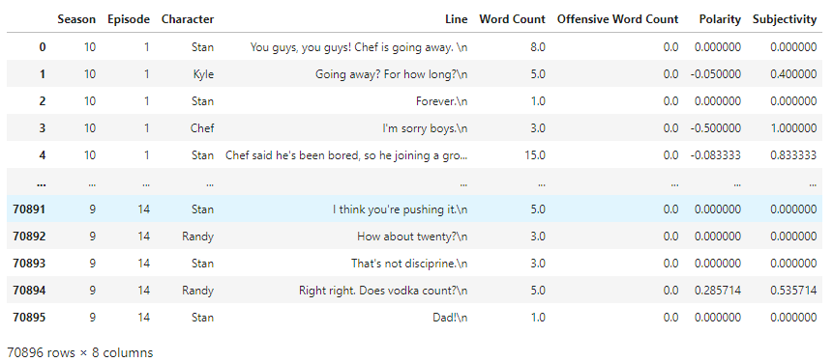
Words Sentiment Over Seasons

Slide 17

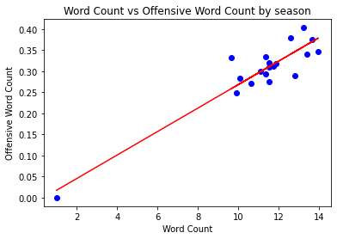
Negative Sentiment Over Seasons

Slide 18
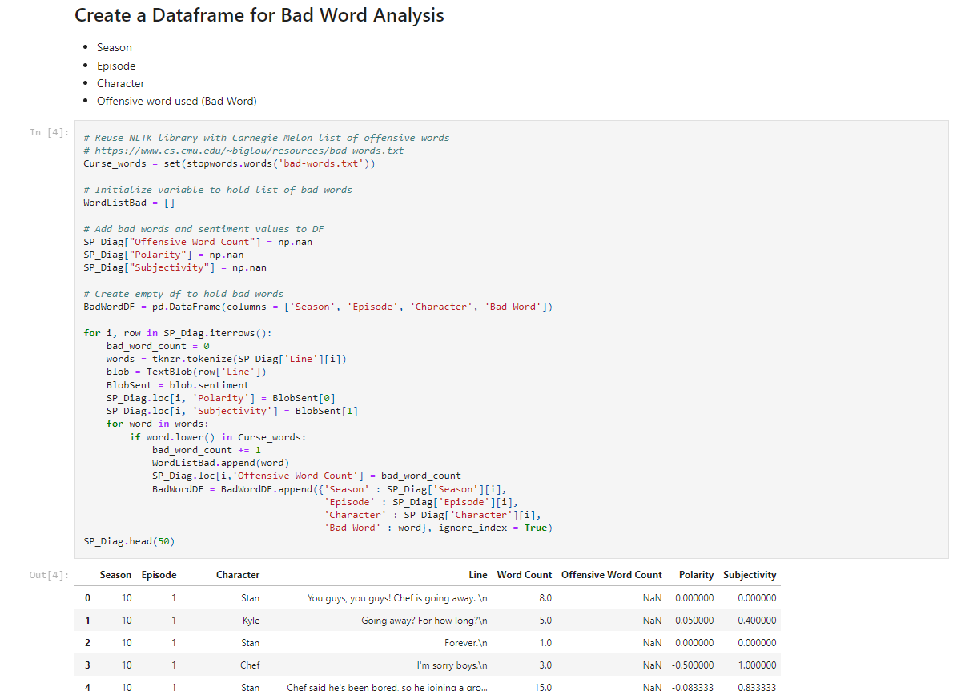
Code for Bad Word Analysis Dataframe

Slide 19
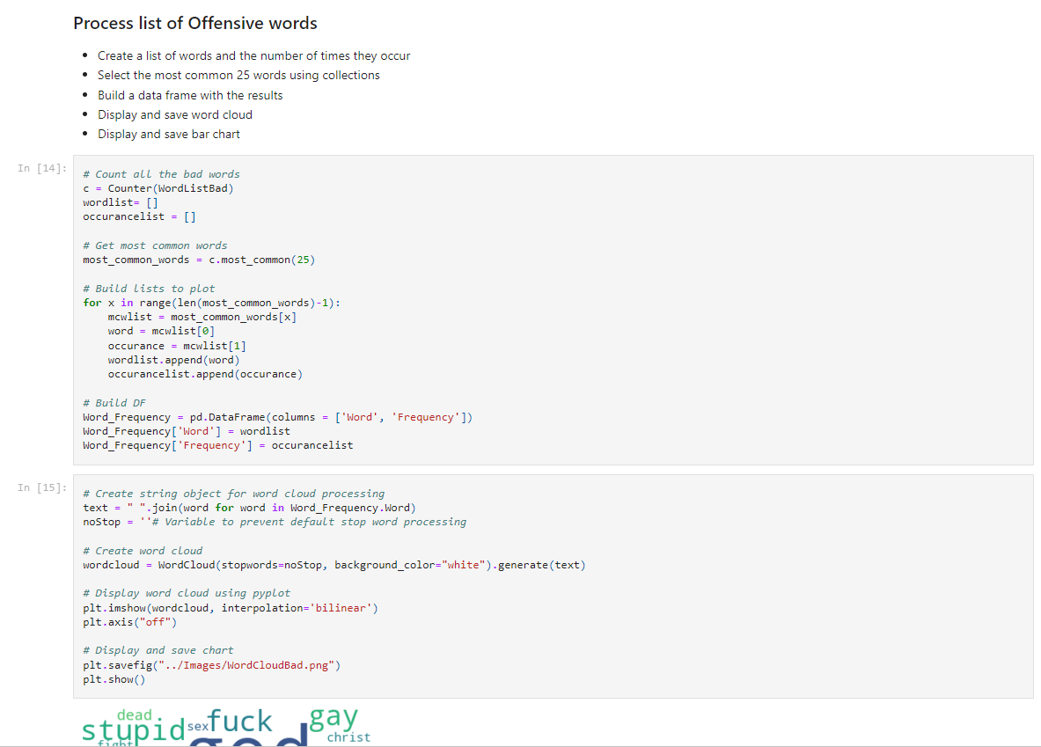
Code for Cleaning Offensive Words

Slide 20
Code For Vader Sentiment Analysis

Slide 21
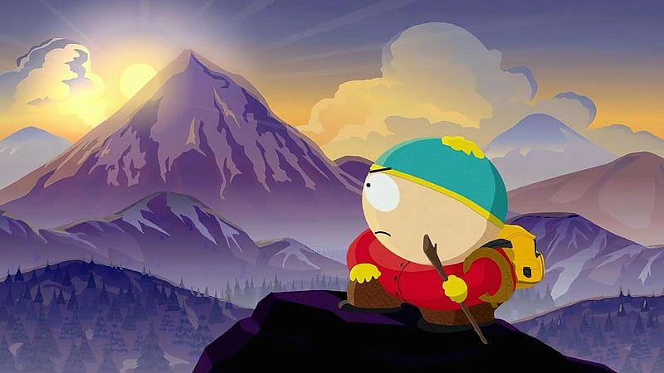
Any Questions?

Slide 22
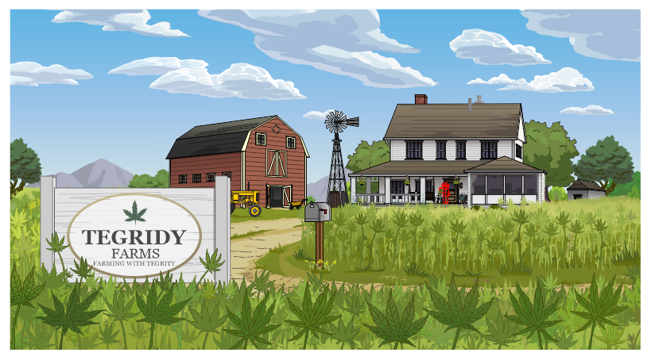
Resources:
South Park Dialogue: More than 70,000 lines of dialogue by season, episode, and character.” via Kaggle
TextBlob, NLTK, Sklearn, TermColor, Better_Profanity, TfidVectorizer, TweetTokenizer as well as matplotlib, pandas, numpy,.
Google Images South Park Characters

